Slide 1

iris
see the world

Slide 2


Slide 3
250 million
people in the world have a visual impairment

Slide 4


Slide 5
OK, IRIS

Slide 6
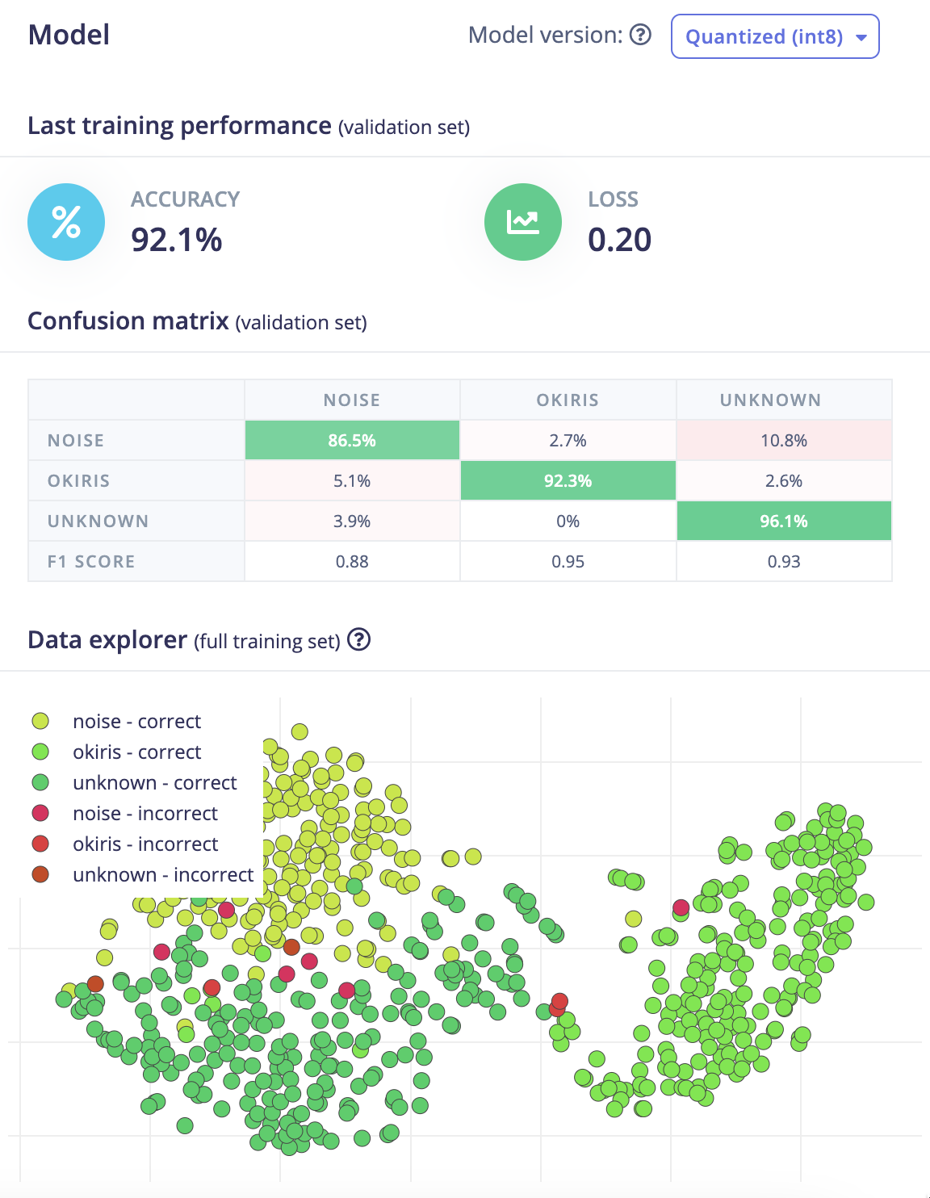


Slide 7
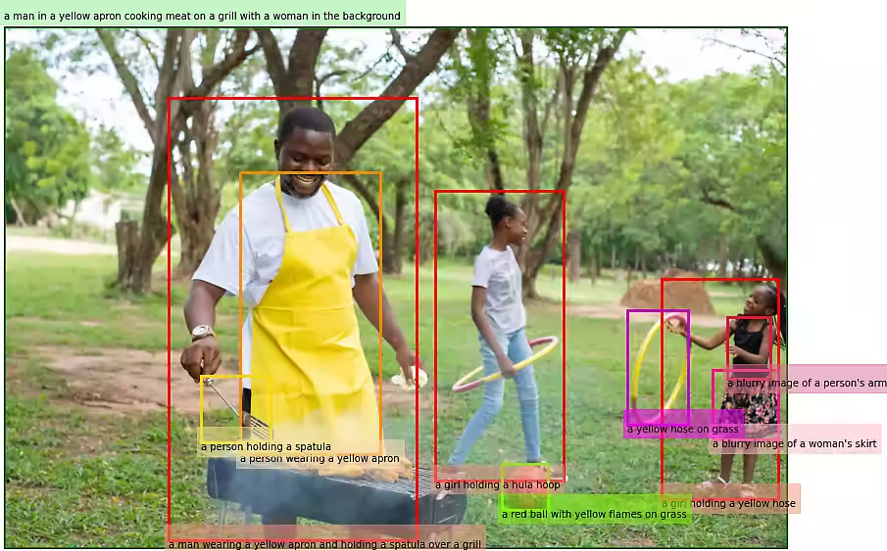

Slide 8



Slide 9
Future
Improvements

Slide 10
iris
see the world

